Slide 1
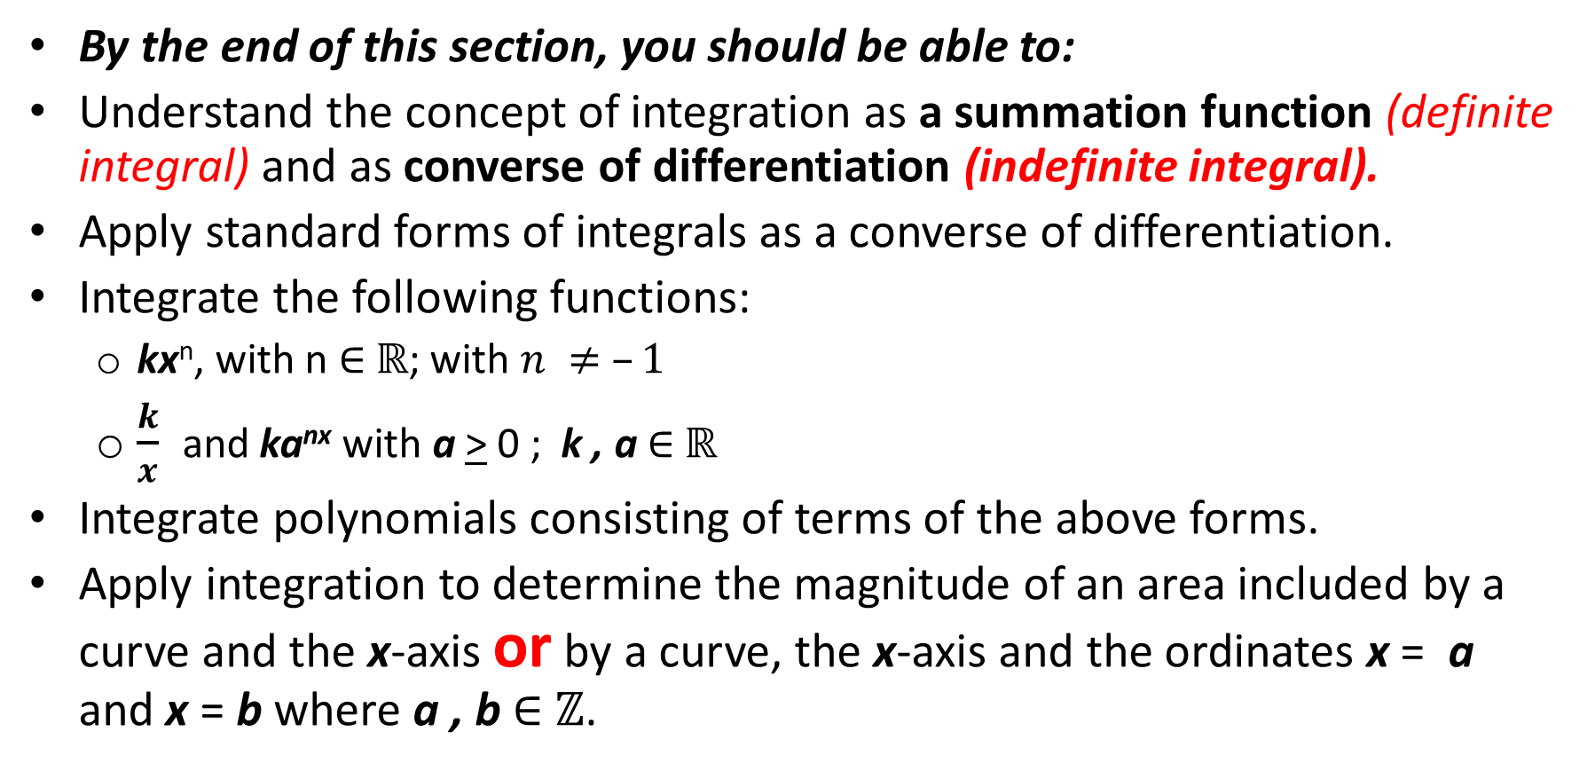
Outcomes for this section
By the end of this section, you should be able to:
Understand the concept of integration as a summation function (definite integral) and as converse of differentiation (indefinite integral).
Apply standard forms of integrals as a converse of differentiation.
Integrate the following functions:
kx^{n}, with n $∈$ $ℝ$; with $n ≠ –1$
$\frac{k}{x}$ and ka^{nx} with a > 0 ; k , a $∈$ $ℝ$
Integrate polynomials consisting of terms of the above forms.
Apply integration to determine the magnitude of an area included by a curve and the x-axis or by a curve, the x-axis and the ordinates x = a and x = b where a , b $∈$ $ℤ$.

Slide 2
Introduction

Slide 3
Activity 1
Activity 1
Write down at least five other functions whose derivative is 4x.

Slide 4
Introduction
You would have noticed that all the functions have the same derivative of 4x, because when we differentiate the constant term we obtain zero.
Hence, when we reverse the process, we have no idea what the original constant term might have been.
So we include in our response an unknown constant, c, called the arbitrary constant of integration.
The integral of 4x then is 2x² + c.

Slide 5
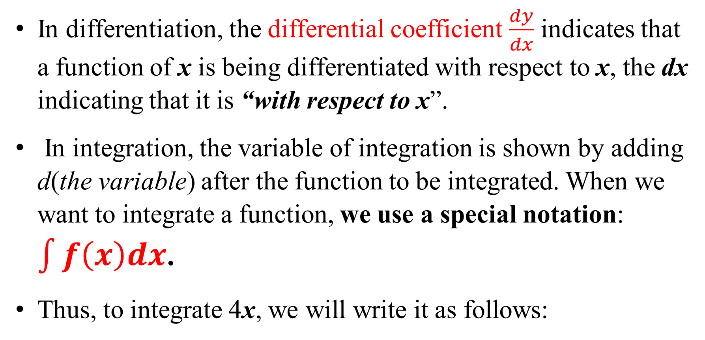
Introduction
In differentiation, the differential coefficient $\frac{dy}{dx}$ indicates that a function of x is being differentiated with respect to x, the dx indicating that it is “with respect to x”.
In integration, the variable of integration is shown by adding d(the variable) after the function to be integrated. When we want to integrate a function, we use a special notation: $\int{f\left(x\right)dx}$.
Thus, to integrate 4x, we will write it as follows:

Slide 6
Introduction

Slide 7
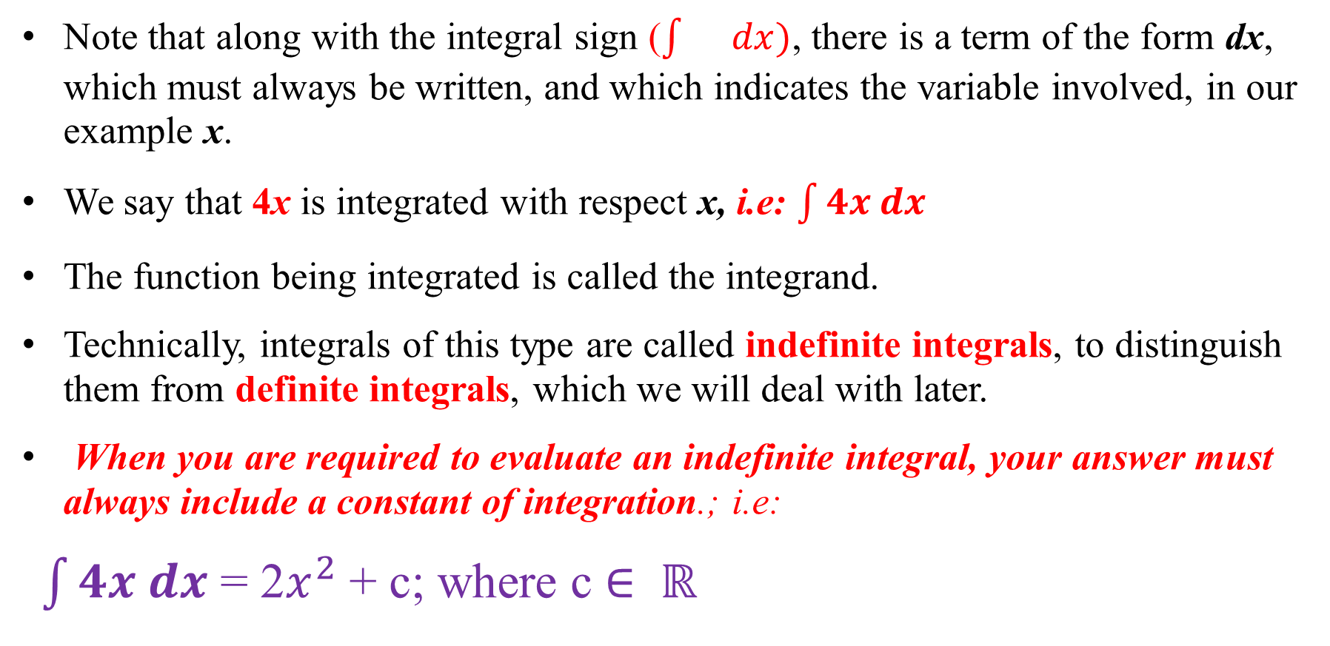
Note that along with the integral sign ($\int{}dx)$, there is a term of the form dx, which must always be written, and which indicates the variable involved, in our example x.
We say that 4x is integrated with respect x, i.e: $\int{4x dx}$
The function being integrated is called the integrand.
Technically, integrals of this type are called indefinite integrals, to distinguish them from definite integrals, which we will deal with later.
When you are required to evaluate an indefinite integral, your answer must always include a constant of integration.; i.e:
$\int{4x dx}$ = 2$x^{2}$ + c; where c $∈ ℝ$

Slide 8
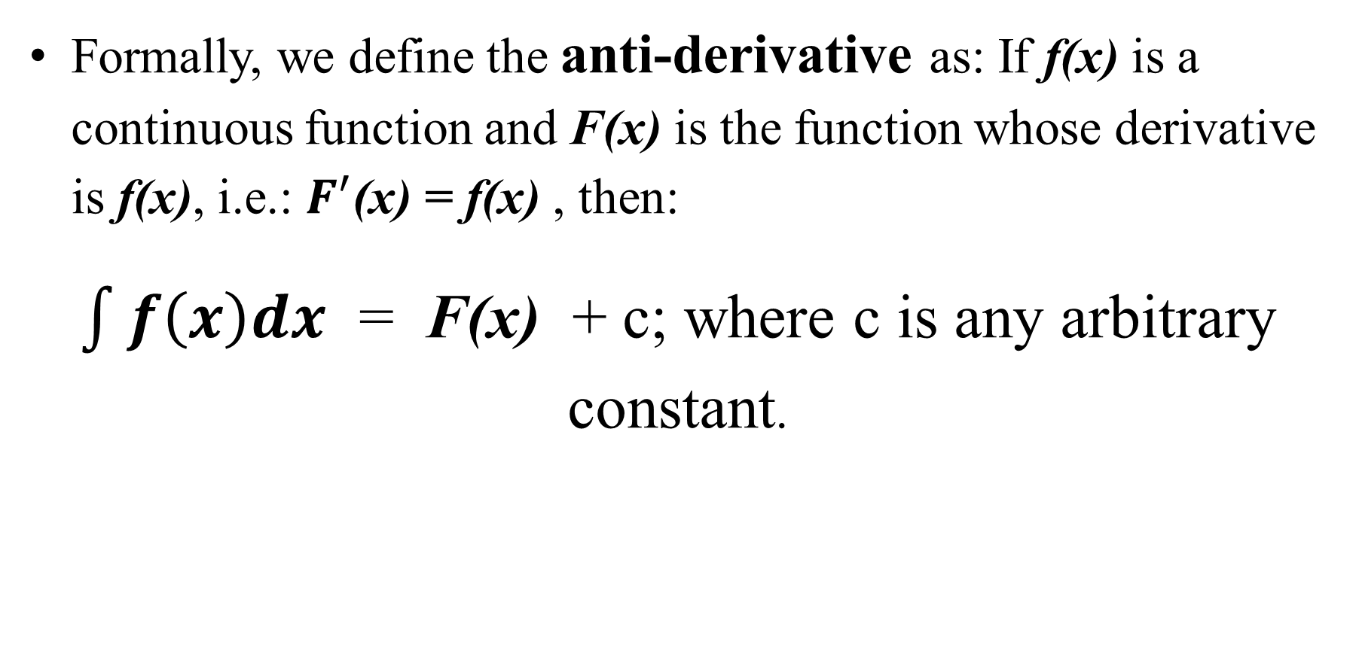
Definition of anti-derivative
Formally, we define the anti-derivative as: If f(x) is a continuous function and F(x) is the function whose derivative is f(x), i.e.: $F^{′}$(x) = f(x) , then:
$\int{f\left(x\right)dx}$ = F(x) + c; where c is any arbitrary constant.

Slide 9
Activity 2

Slide 10
Activity 2
Differentiate
Integrate
ax^{n}

Slide 11
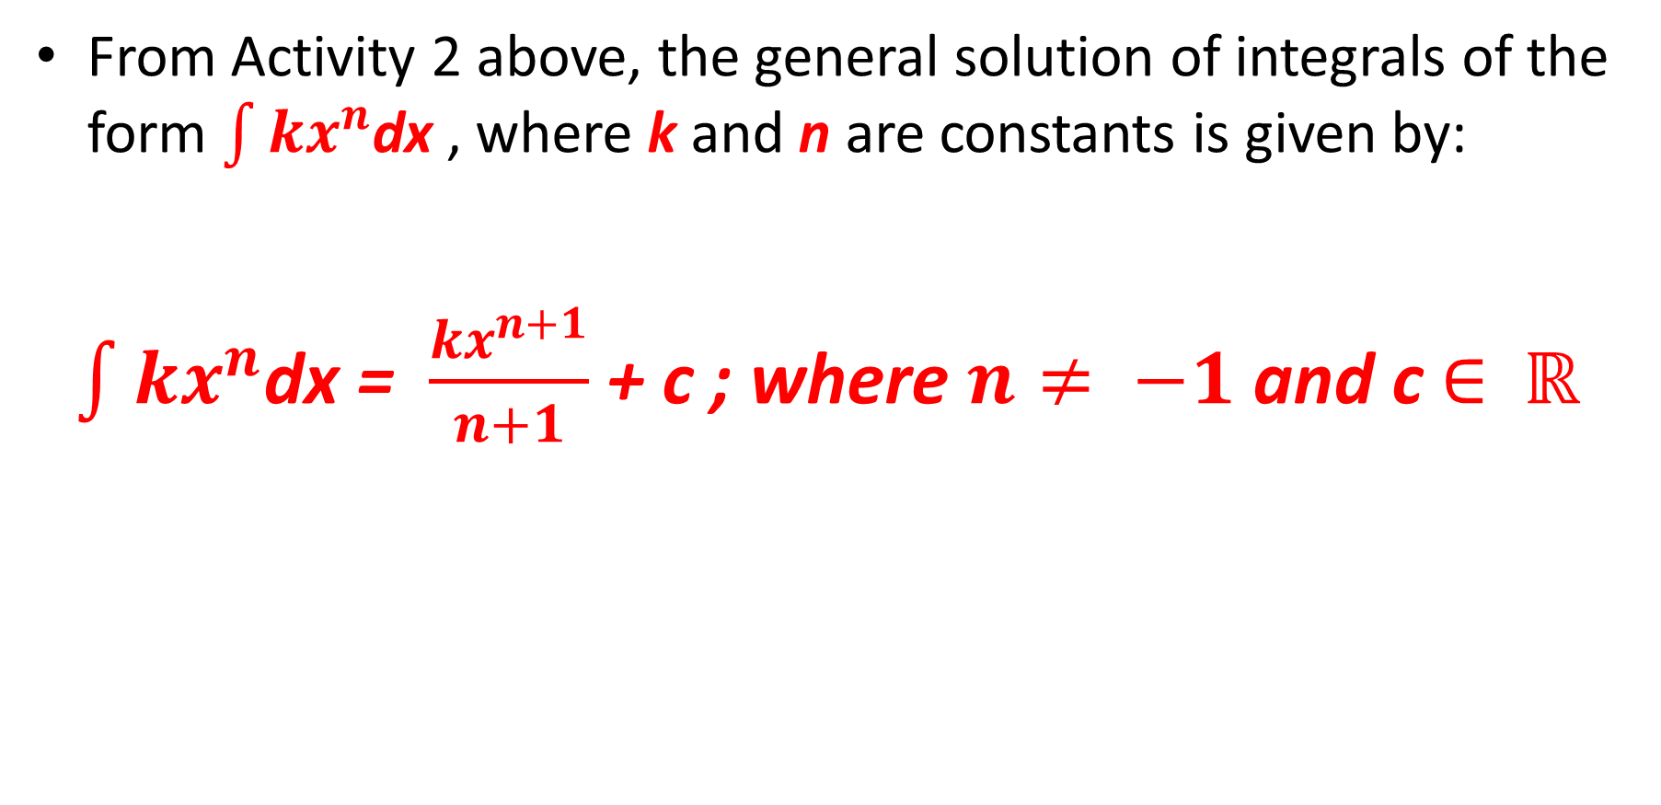
The general solution of integrals of the form kx^{n}
From Activity 2 above, the general solution of integrals of the form $\int{kx^{n}}$dx , where k and n are constants is given by:
$\int{kx^{n}}$dx = $\frac{kx^{n+1}}{n+1}$ + c ; where $n≠ −1$ and c $∈$ $ℝ$

Slide 12
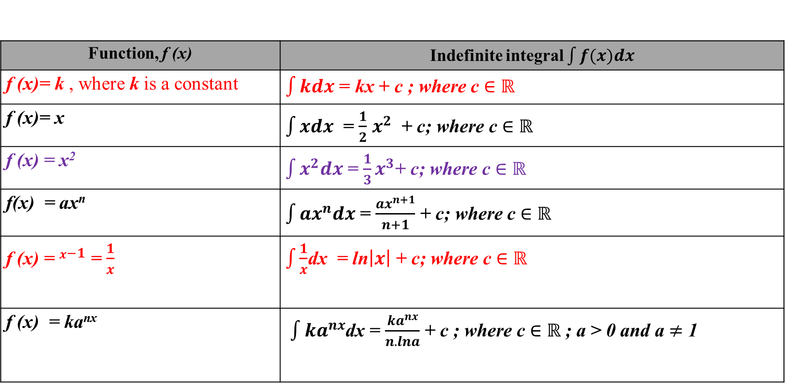
Table of ready to use integrals
Function, f (x) | Indefinite integral $\int{f(x)dx}$
f (x)= k , where k is a constant | $\int{kdx}$ = kx + c ; where c $∈$ $ℝ$
f (x)= x | $\int{xdx}$ = $\frac{1}{2}$ $x^{2}$ + c; where c $∈$ $ℝ$
f (x) = x² | $\int{x^{2}dx}$ = $\frac{1}{3}x^{3}$+ c; where c $∈$ $ℝ$
f(x) = ax^{n} | $\int{{ax}^{n}dx}$ = $\frac{{ax}^{n+1}}{n+1}$ + c; where c $∈$ $ℝ$
f (x) = $x^{−1}$ = $\frac{1}{x}$ | $\int{\frac{1}{x}}$dx = ln$\left|x\right|$ + c; where c $∈$ $ℝ$
f (x) = ka^{nx} | $\int{{ka}^{nx}}$dx = $\frac{{ka}^{nx}}{n.lna}$ + c ; where c $∈$ $ℝ$ ; a > 0 and a $≠$ 1

Slide 13
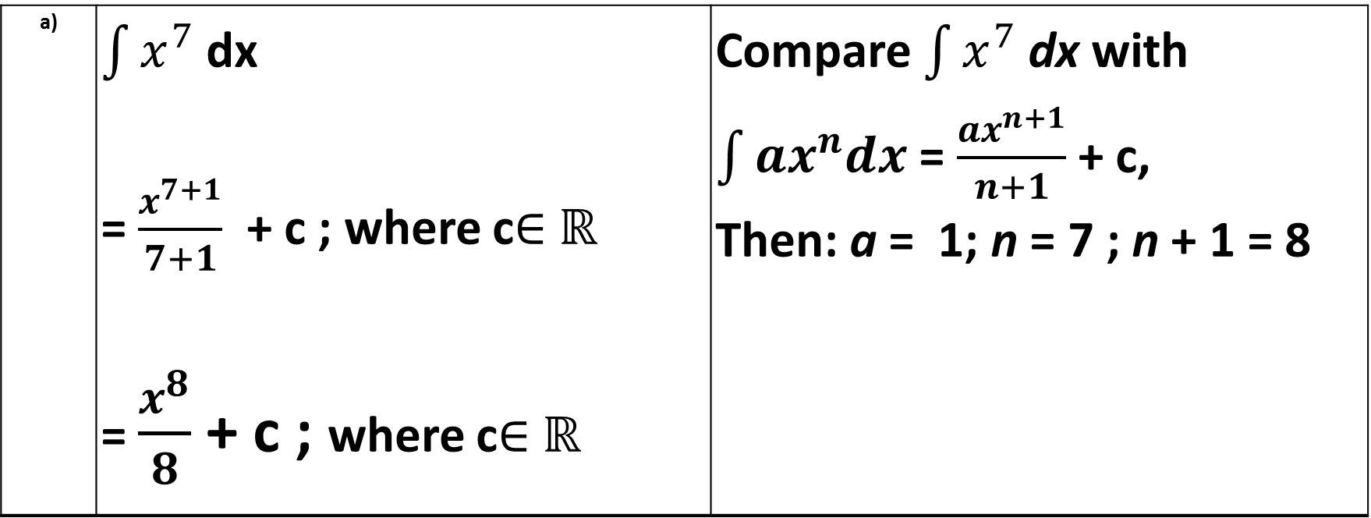
Worked Examples: Indefinite integrals
a) | $\int{x^{7}}$ dx = $\frac{x^{7+1}}{7+1}$ + c ; where c$∈$ $ℝ$ = $\frac{x^{8}}{8}$ + c ; where c$∈$ $ℝ$ | Compare $\int{x^{7}}$ dx with $\int{ax^{n}dx}$ = $\frac{{ax}^{n+1}}{n+1}$ + c, Then: a = 1; n = 7 ; n + 1 = 8

Slide 14
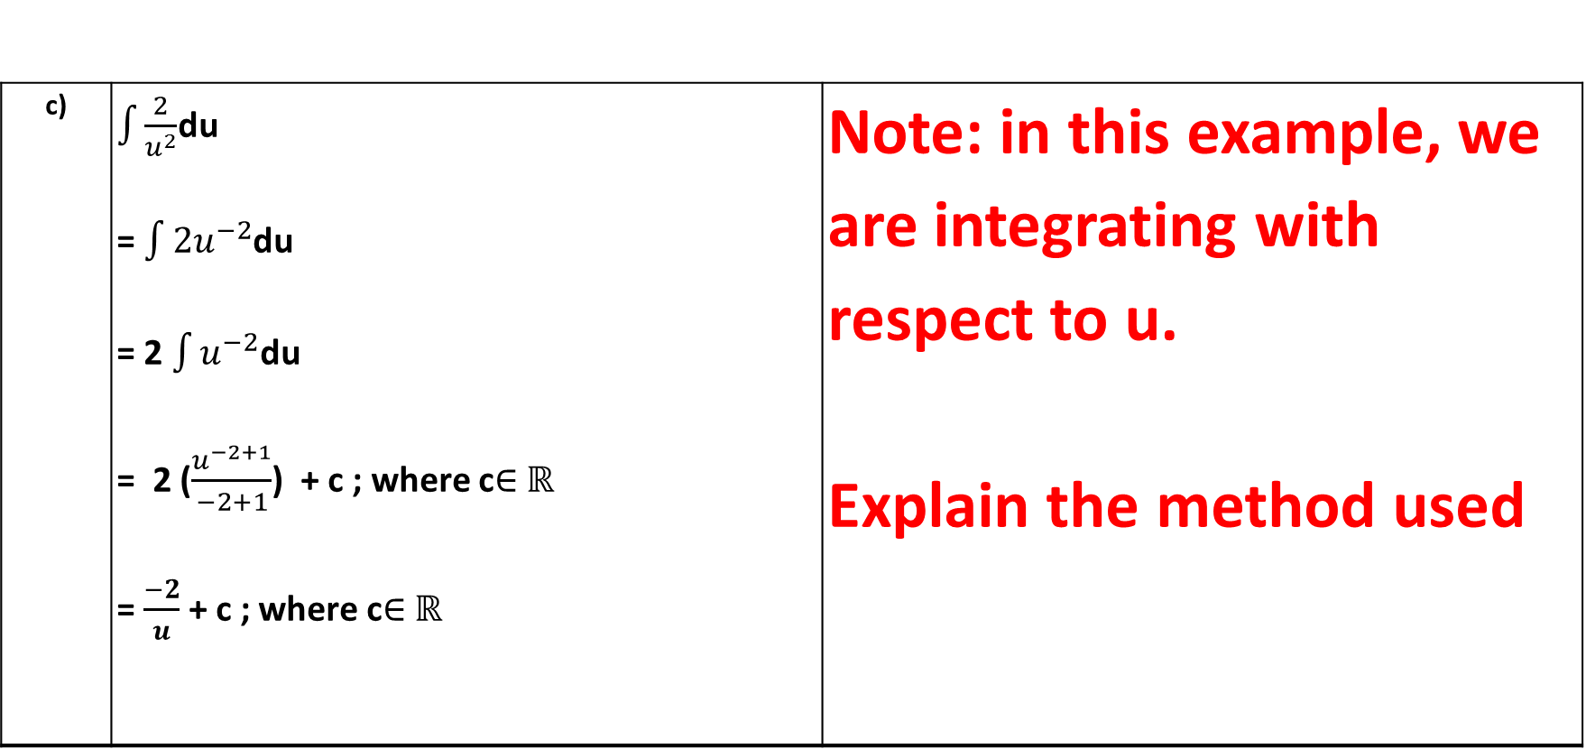
Worked Examples: Indefinite integrals
c) | $\int{\frac{2}{u^{2}}}$du = $\int{2u^{−2}}$du = 2 $\int{u^{−2}}$du = 2 ($\frac{u^{−2+1}}{−2+1}$) + c ; where c$∈$ $ℝ$ = $\frac{−2}{u}$ + c ; where c$∈$ $ℝ$ | Note: in this example, we are integrating with respect to u. Explain the method used

Slide 15
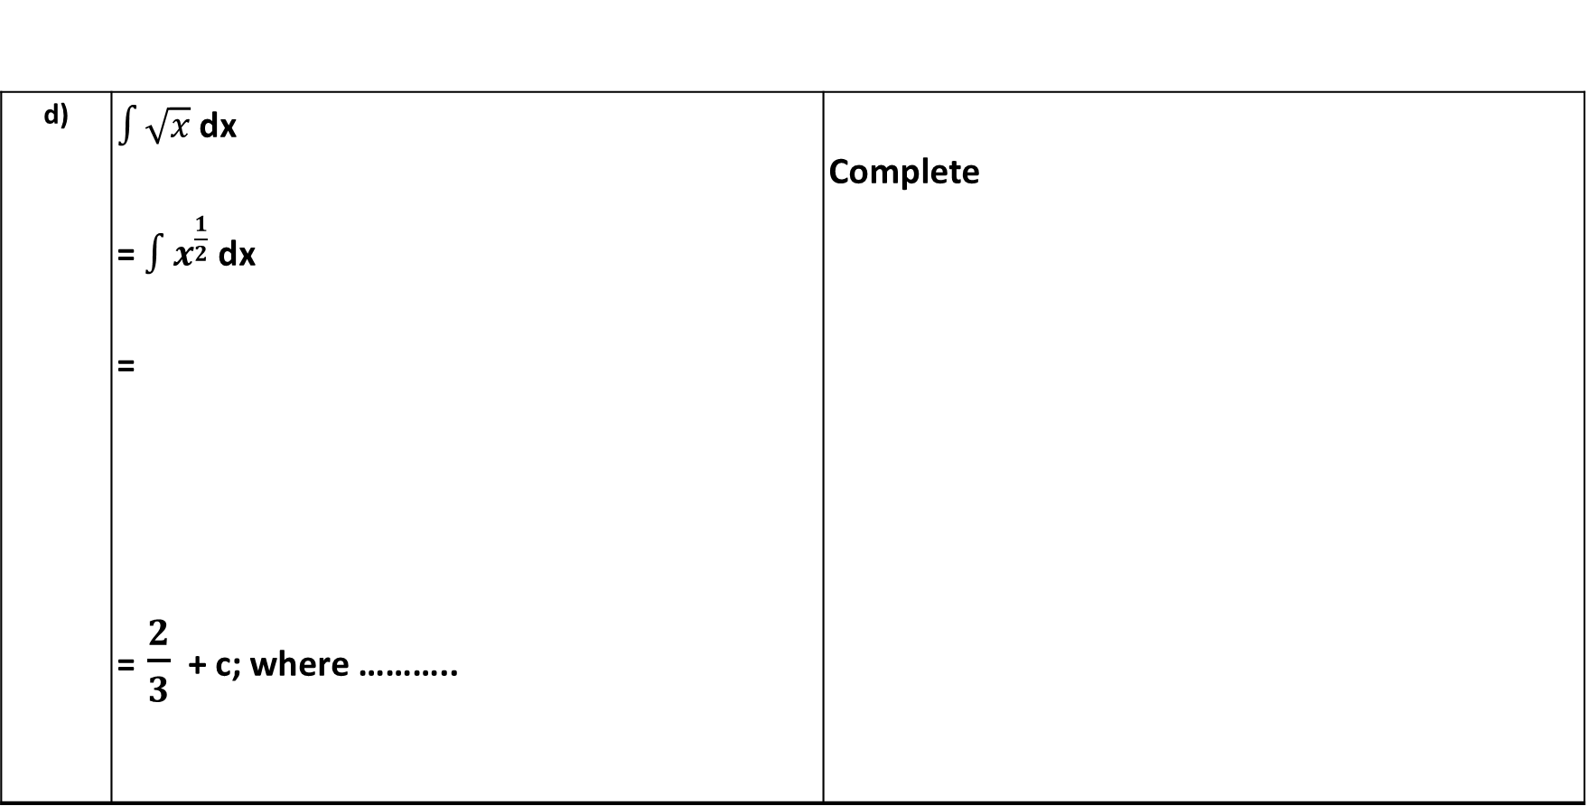
Worked Examples: Indefinite integrals
d) | $\int{\sqrt{x}}$ dx = $\int{x^{\frac{1}{2}}}$ dx = = $\frac{2}{3}$ + c; where ……….. | Complete

Slide 16
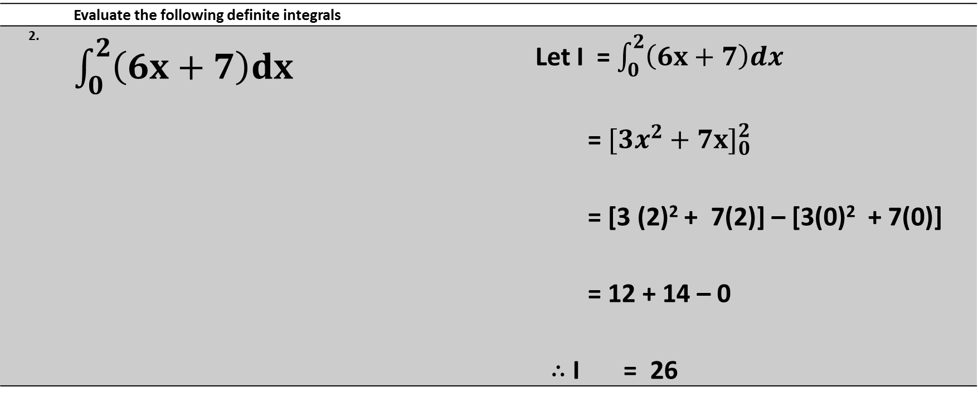
Worked examples – the definite integral
 | Evaluate the following definite integrals
2. | $\int_{0}^{2}{\left(6x+7\right)dx}$ | Let I = $\int_{0}^{2}{\left(6x+7\right)dx}$ = ${[3x^{2}+7x]}_{0}^{2}$ = [3 (2)² + 7(2)] – [3(0)² + 7(0)] = 12 + 14 – 0 $∴$I = 26

Slide 17
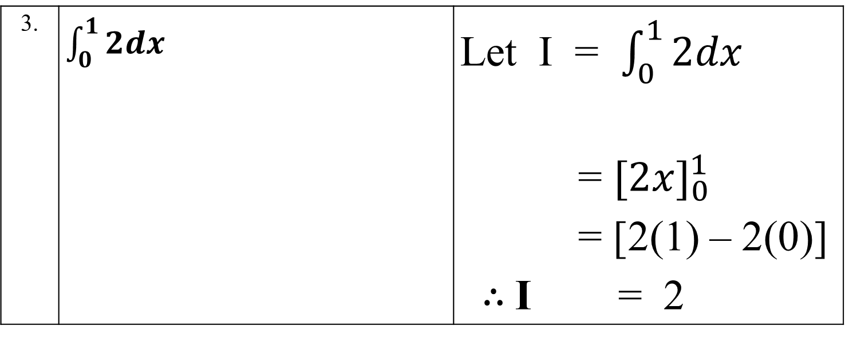
Worked examples- The definite integral
3. | $\int_{0}^{1}{2dx}$ | Let I = $\int_{0}^{1}{2dx}$ = ${[2x]}_{0}^{1}$ = [2(1) – 2(0)] $∴$I = 2

Slide 18
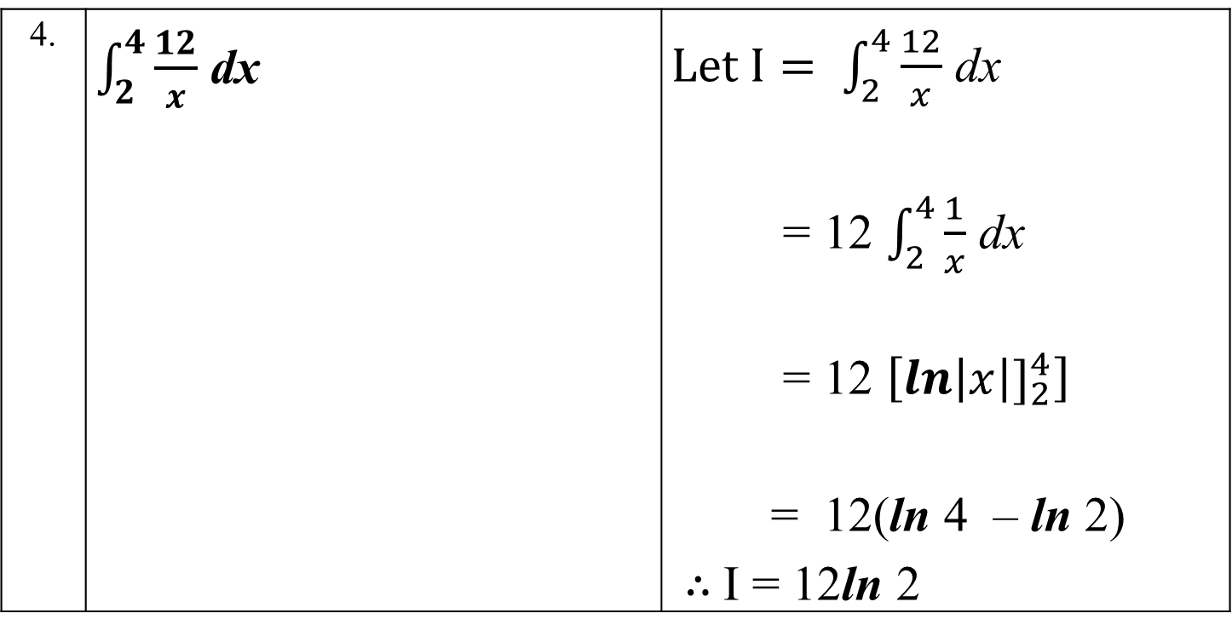
Worked examples- The definite integral
4. | $\int_{2}^{4}{\frac{12}{x}}$ dx | $Let I= \int_{2}^{4}{\frac{12}{x}}$ dx = 12 $\int_{2}^{4}{\frac{1}{x}}$ dx = 12 $\left[{\ln\left|x\right|]}_{2}^{4}\right]$ = 12(ln 4 – ln 2) $∴$I = 12ln 2

Slide 19
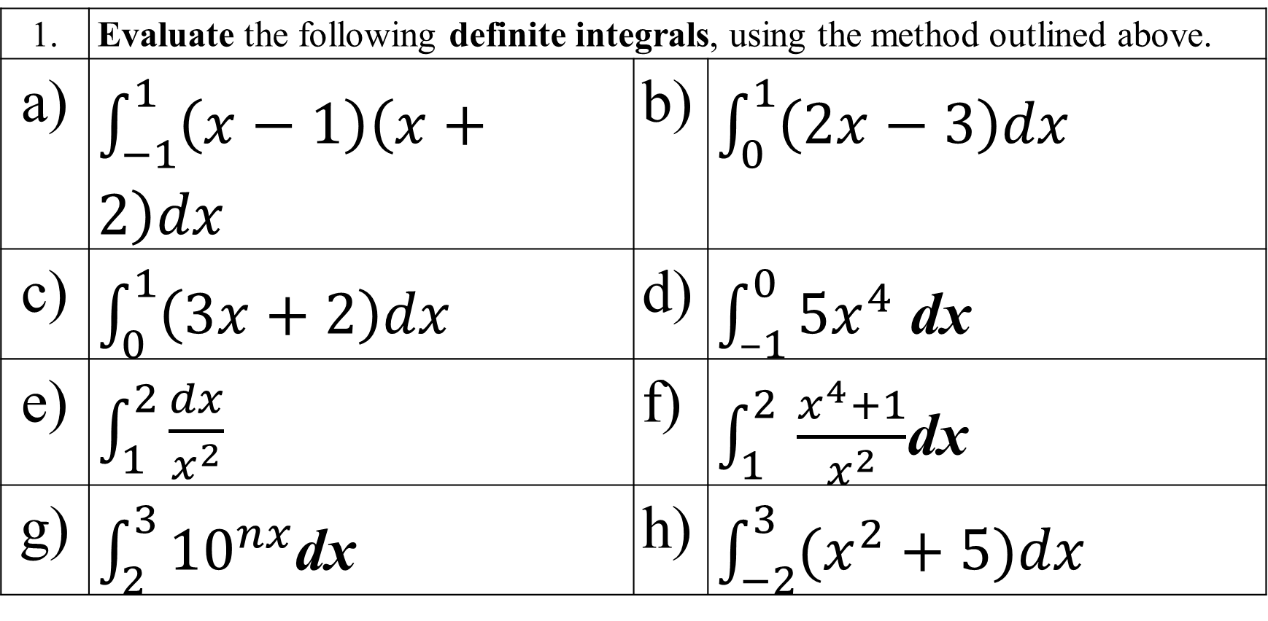
Activity 5
1. | Evaluate the following definite integrals, using the method outlined above.
a) | $\int_{−1}^{1}{\left(x−1\right)\left(x+2\right)dx}$ | b) | $\int_{0}^{1}{\left(2x−3\right)dx}$
c) | $\int_{0}^{1}{\left(3x+2\right)dx}$ | d) | $\int_{–1}^{0}{{5x}^{4}}$ dx
e) | $\int_{1}^{2}{\frac{dx}{x^{2}}}$ | f) | $\int_{1}^{2 }{\frac{x^{4}+1}{x^{2}}}$dx
g) | $\int_{2}^{3}{{10}^{nx}}$dx | h) | $\int_{−2}^{3}{(x^{2}}+5)dx$

Slide 20
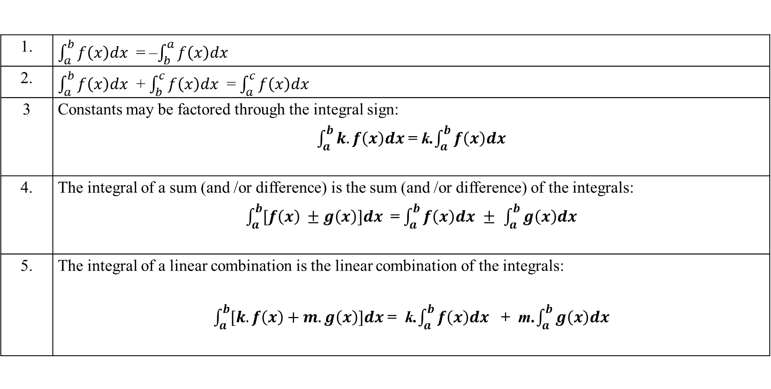
Some properties of integrals
Here are some simple properties of the integral that are often used in computations. Throughout take f and g as continuous functions.
1. | $\int_{a}^{b}{f\left(x\right)dx}$ = –$\int_{b}^{a}{f\left(x\right)dx}$
2. | $\int_{a}^{b}{f\left(x\right)dx}$ + $\int_{b}^{c}{f\left(x\right)dx}$ = $\int_{a}^{c}{f\left(x\right)dx}$
3 | Constants may be factored through the integral sign: $\int_{a}^{b}{k.f\left(x\right)dx}$ = k.$\int_{a}^{b}{f\left(x\right)dx}$
4. | The integral of a sum (and /or difference) is the sum (and /or difference) of the integrals: $\int_{a}^{b}{[f\left(x\right) ±g\left(x\right)]dx}$ = $\int_{a}^{b}{f\left(x\right)dx}$ $±$ $\int_{a}^{b}{g\left(x\right)dx}$
5. | The integral of a linear combination is the linear combination of the integrals: $\int_{a}^{b}{[k.f\left(x\right)+m.g\left(x\right)]dx}$ = k.$\int_{a}^{b}{f\left(x\right)dx}$ + m.$\int_{a}^{b}{g\left(x\right)dx}$

Slide 21
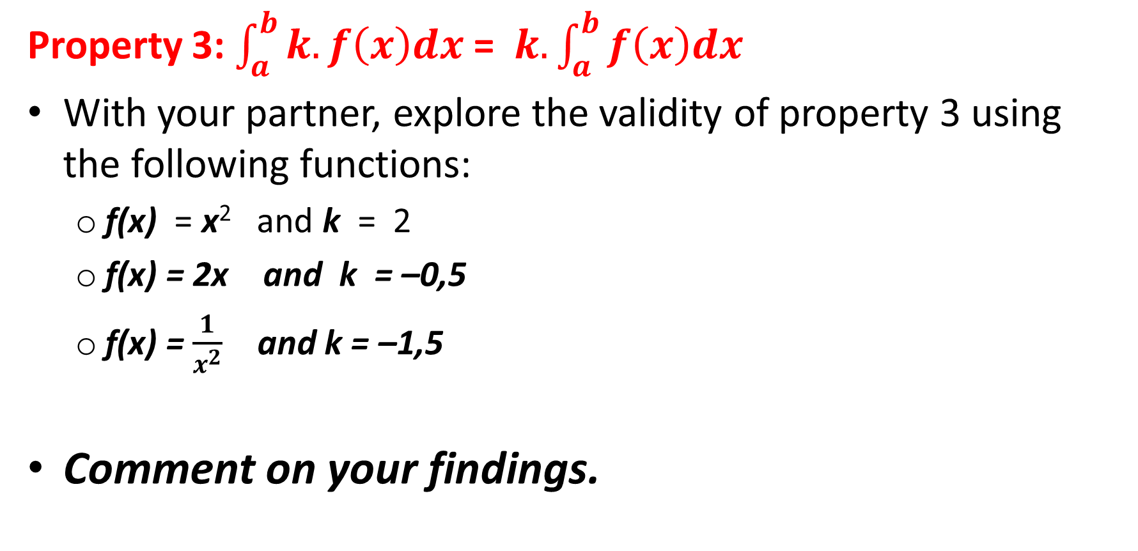
Activity 6
Property 3: $\int_{a}^{b}{k.f\left(x\right)dx}$ = $k.\int_{a}^{b}{f\left(x\right)dx}$
With your partner, explore the validity of property 3 using the following functions:
f(x) = x² and k = 2
f(x) = 2x and k = –0,5
f(x) = $\frac{1}{x^{2}}$ and k = –1,5
Comment on your findings.

Slide 22
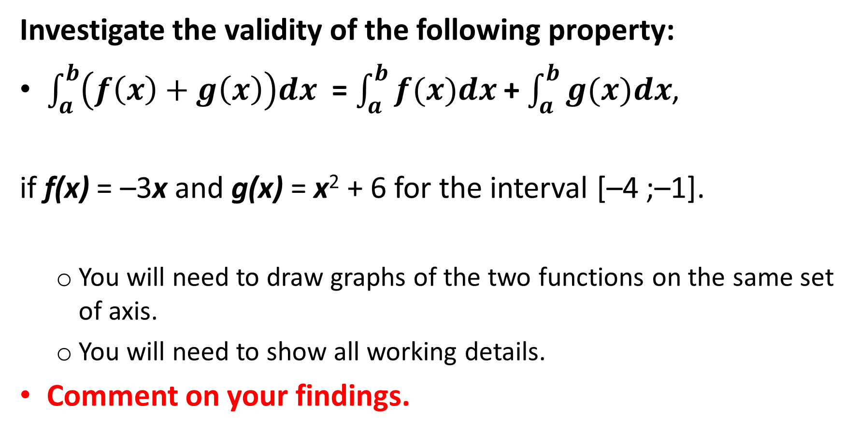
Activity 7
Investigate the validity of the following property:
$\int_{a}^{b}{\left(f\left(x\right)+g\left(x\right)\right)dx}$ = $\int_{a}^{b}{f(x)dx}$ + $\int_{a}^{b}{g(x)dx}$,
if f(x) = –3x and g(x) = x² + 6 for the interval [–4 ;–1].
You will need to draw graphs of the two functions on the same set of axis.
You will need to show all working details.
Comment on your findings.

Slide 23
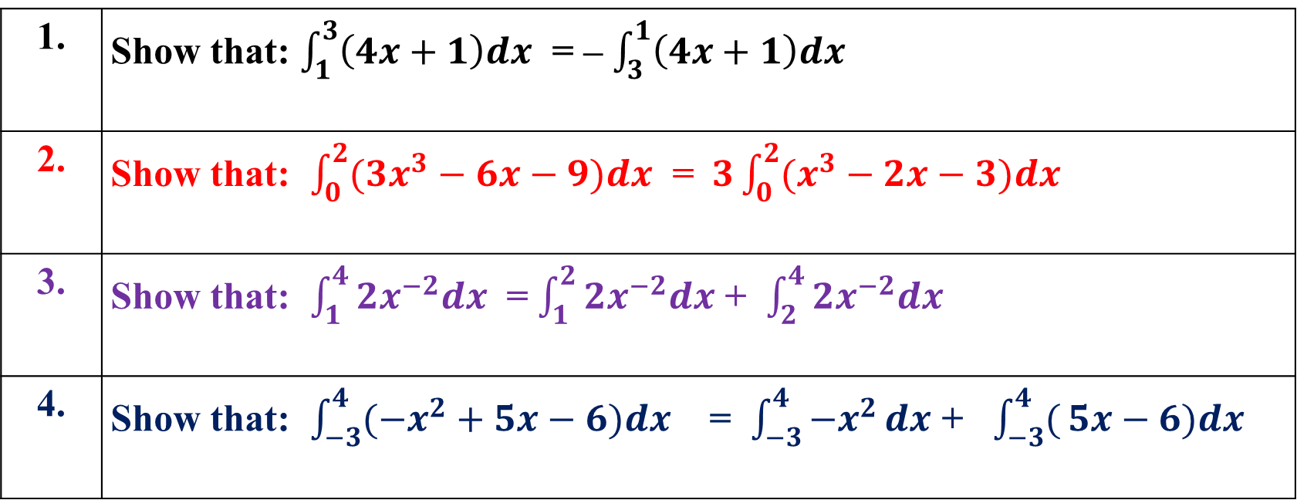
Activity 8
1. | Show that: $\int_{1}^{3}{\left(4x+1\right)dx}$ = – $\int_{3}^{1}{\left(4x+1\right)dx}$
2. | Show that: $\int_{0}^{2}{(3x^{3}}−6x−9)dx$ = $3\int_{0}^{2}{(x^{3}}−2x−3)dx$
3. | Show that: $\int_{1}^{4}{2x^{−2}dx}$ = $\int_{1}^{2}{2x^{−2}dx}$ + $\int_{2}^{4}{2x^{−2}dx}$
4. | Show that: $\int_{−3}^{4}{(−x^{2}}+5x−6)dx$ = $\int_{−3}^{4}{−x^{2}}dx$ + $\int_{−3}^{4}{(}5x−6)dx$

Slide 24
Area under a curve
Use the properties of definite integrals developed in the previous section to calculate the area under a curve.
NB: If asked to evaluate a definite integral without explicitly asked to calculate the area, then proceed to evaluate the definite integral without concern about the answer-i.e the answer can be 0 or a negative value!!

Slide 25
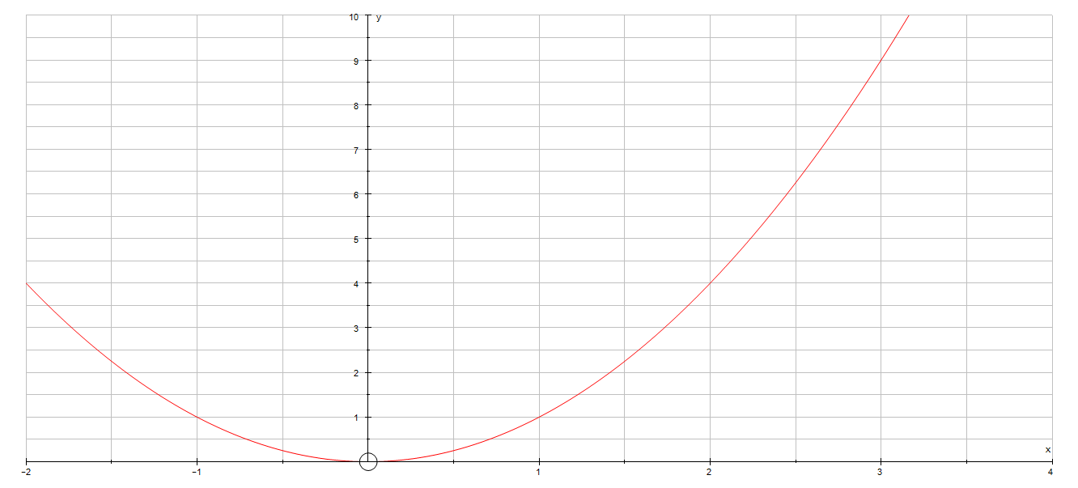

Area under a curve- Worked example
Find the area under the curve y = x² , between x = 1 and x = 3.
Let the required area be A , then:
A = $\int_{1}^{3}{x^{2}dx}$
= $[{\frac{x^{3}}{3}]}_{1}^{3}$
= $\frac{3^{3}}{3}$ – $\frac{1^{3}}{3}$
A = $\frac{26}{3}$ square units

Slide 26
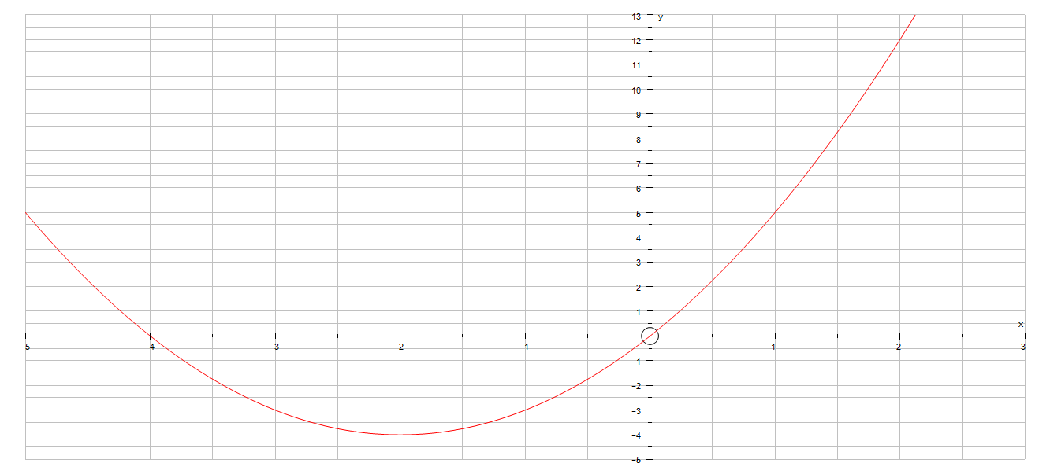
Area under a curve
Find the area between the curve y = x² + 4x and the x-axis from:
x = – 2 to x = 0
x = 0 to x = 2
x = – 2 to x = 2
A₂
A₁

Slide 27
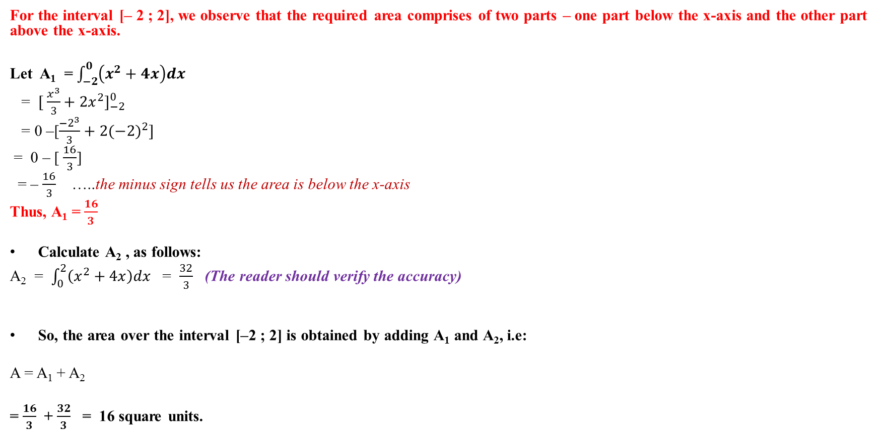
Worked example 2
For the interval [– 2 ; 2], we observe that the required area comprises of two parts – one part below the x-axis and the other part above the x-axis.
Let A₁ = $\int_{−2}^{0}{\left(x^{2}+4x\right)dx}$
= $[ \frac{x^{3}}{3}{+ 2x^{2}]}_{−2}^{0}$
= 0 –[$\frac{{−2}^{3}}{3}+2({−2)}^{2}]$
= 0 – [ $\frac{16}{3}$]
= – $\frac{16}{3}$ …..the minus sign tells us the area is below the x-axis
Thus, A₁ = $\frac{16}{3}$
Calculate A₂ , as follows:
A₂ = $\int_{0}^{2}{\left(x^{2}+4x\right)dx}$ = $\frac{32}{3}$ (The reader should verify the accuracy)
So, the area over the interval [–2 ; 2] is obtained by adding A₁ and A₂, i.e:
A = A₁ + A₂
= $\frac{16}{3}$ + $\frac{32}{3}$ = 16 square units.

Slide 28
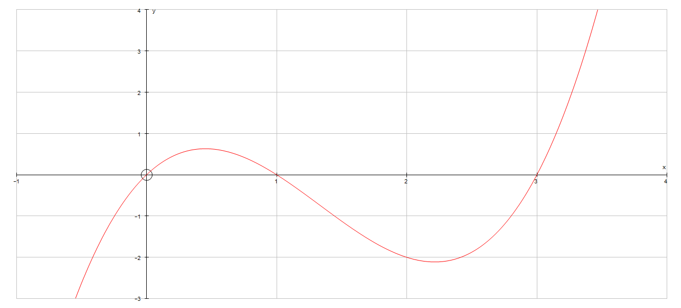
Own work
With your partner, attempt the following.
The given sketch is a graphical representation of the function defined by: f(x) = x³ – 4x² + 3x.
Determine the area between the curve and the x-axis from x = 0 to x = 3.

Slide 29
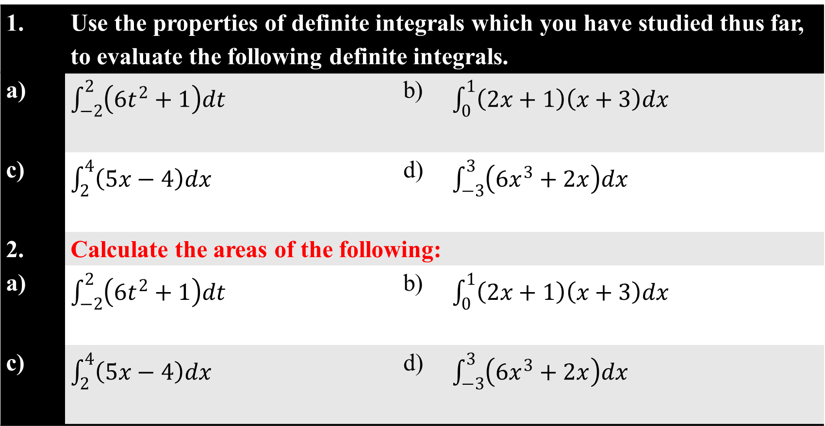
Activity 9
1. | Use the properties of definite integrals which you have studied thus far, to evaluate the following definite integrals.
a) | $\int_{−2}^{2}{\left(6t^{2}+1\right)dt}$ |  | b) | $\int_{0}^{1}{\left(2x+1\right)\left(x+3\right)dx}$
c) | $\int_{2}^{4}{\left(5x−4\right)dx}$ |  | d) | $\int_{−3}^{3}{\left({6x}^{3}+2x\right)dx}$
2. | Calculate the areas of the following:
a) | $\int_{−2}^{2}{\left(6t^{2}+1\right)dt}$ |  | b) | $\int_{0}^{1}{\left(2x+1\right)\left(x+3\right)dx}$
c) | $\int_{2}^{4}{\left(5x−4\right)dx}$ |  | d) | $\int_{−3}^{3}{\left({6x}^{3}+2x\right)dx}$

